Slide 1

Bacchus Winery Database Design
Group 3: Javonta Young, Mason Buller, Margaret Shimerdla, Julio Cruz Romero

Slide 2
Bacchus Winery Case Study Summary
The company was inherited by two sons who wanted to keep all current personnel. They have managers for finances and payroll, marketing, and production. They also have a marketing assistant and twenty production line workers.
They grow grapes to make Merlot, Cabernet, Chablis, and Chardonnay.
They receive bottling supplies from three different suppliers and have two people in charge of keeping track of supply deliveries and inventory.
They want a more efficient way to keep track of ordering supplies, track shipments, and allow their distributors to order online.

Slide 3
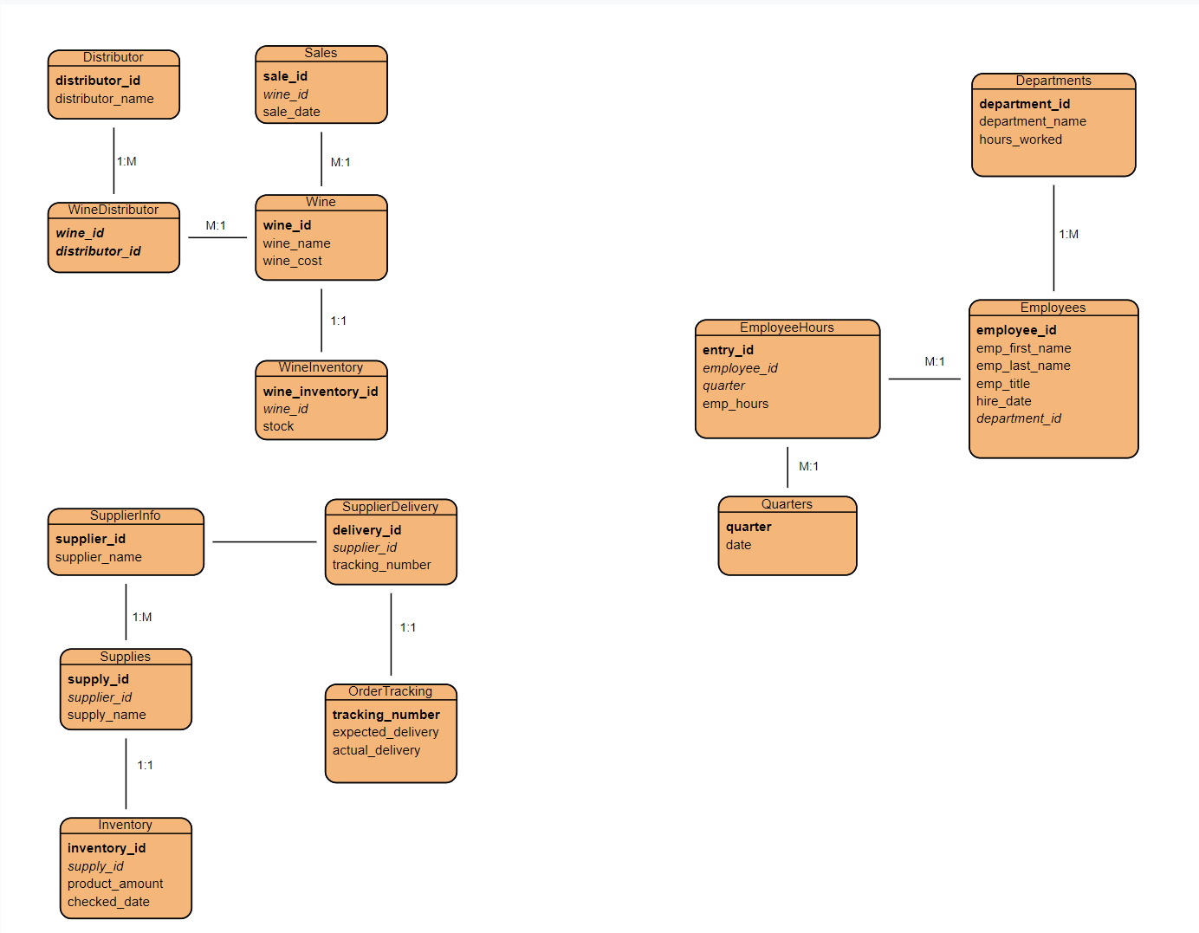
Entity Relationship Design

Slide 4
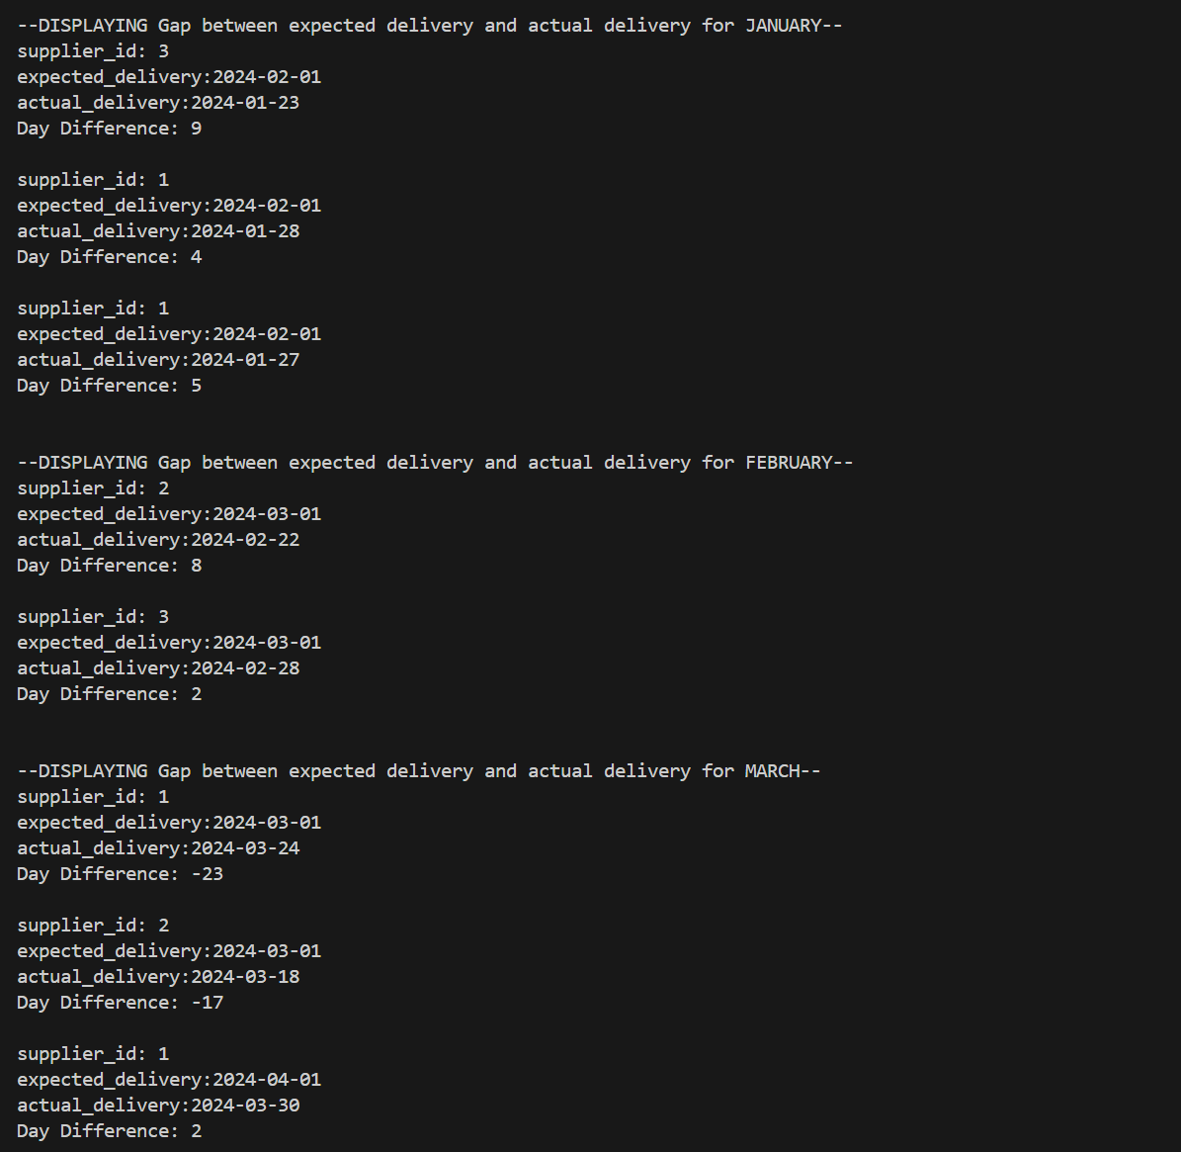
Report 1
Are all suppliers delivering on time?
Is there a large gap between expected delivery and actual delivery?
A month-by-month report should show problem areas.

Slide 5
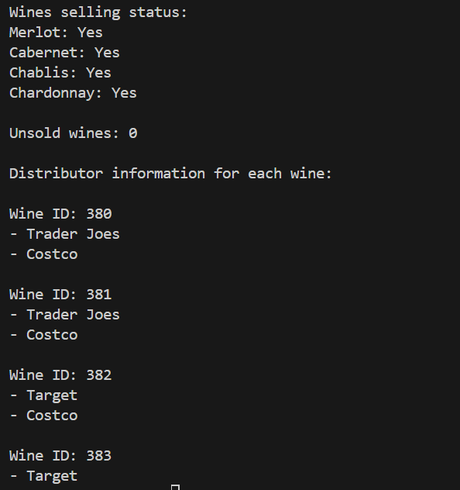
Report 2
The wine distribution, are all wines selling as they thought?
Is one wine not selling?
Which distributor carries which wine?

Slide 6
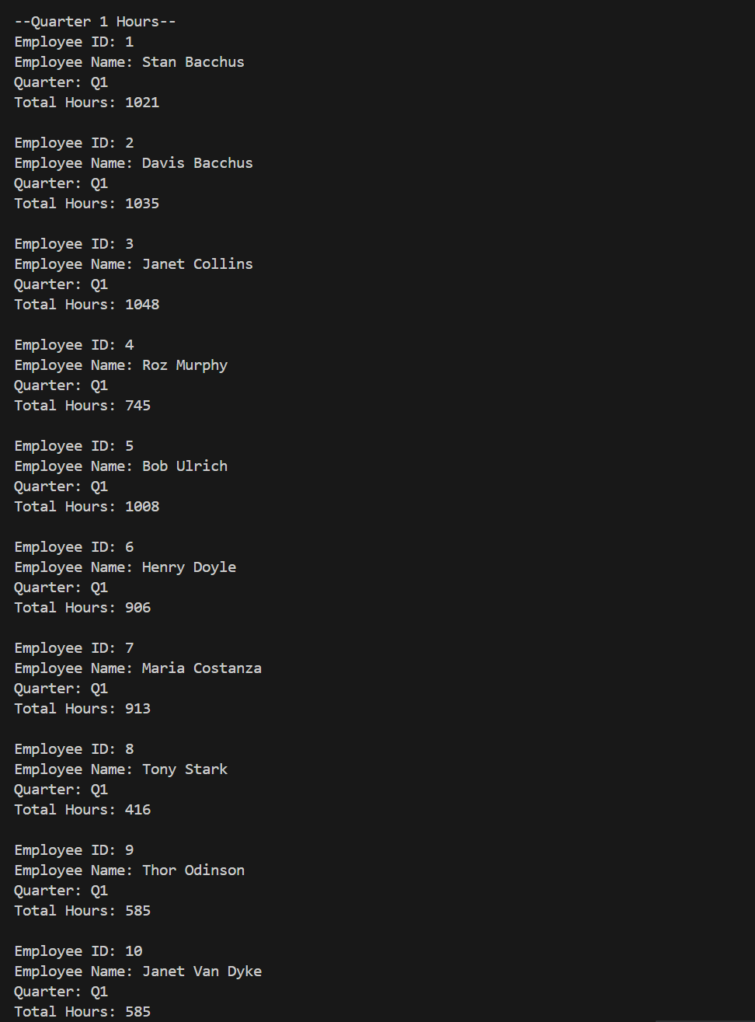
Report 3
During the last 4 quarters, How many hours did each employee work?

Slide 7
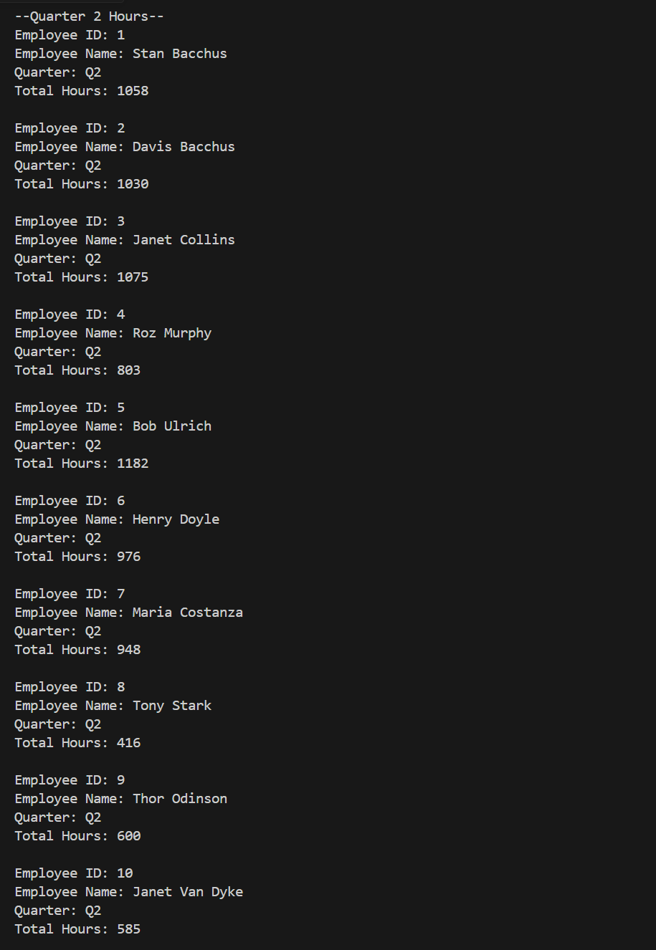
Report 3 (cont’d)
Quarter 2 Results

Slide 8
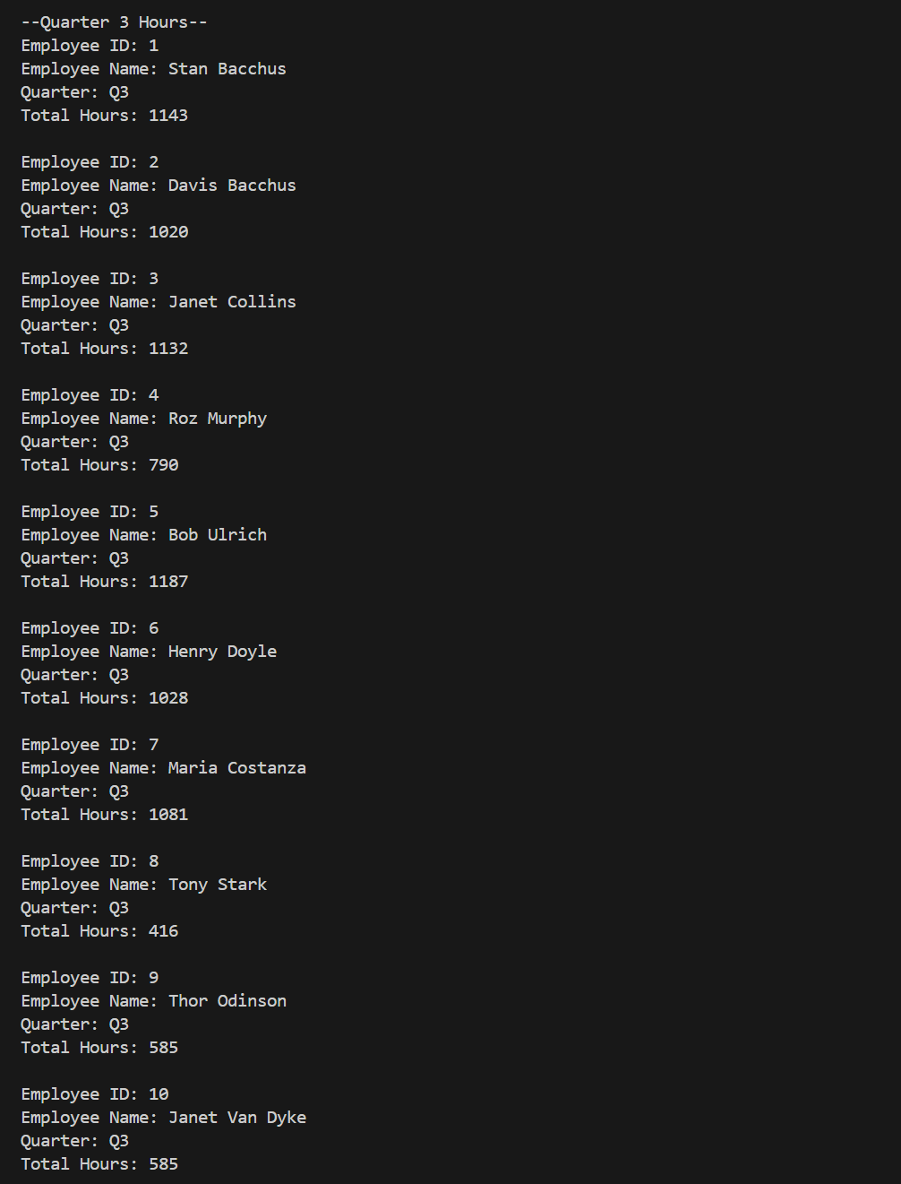
Report 3 (cont’d)
Quarter 3 Results

Slide 9
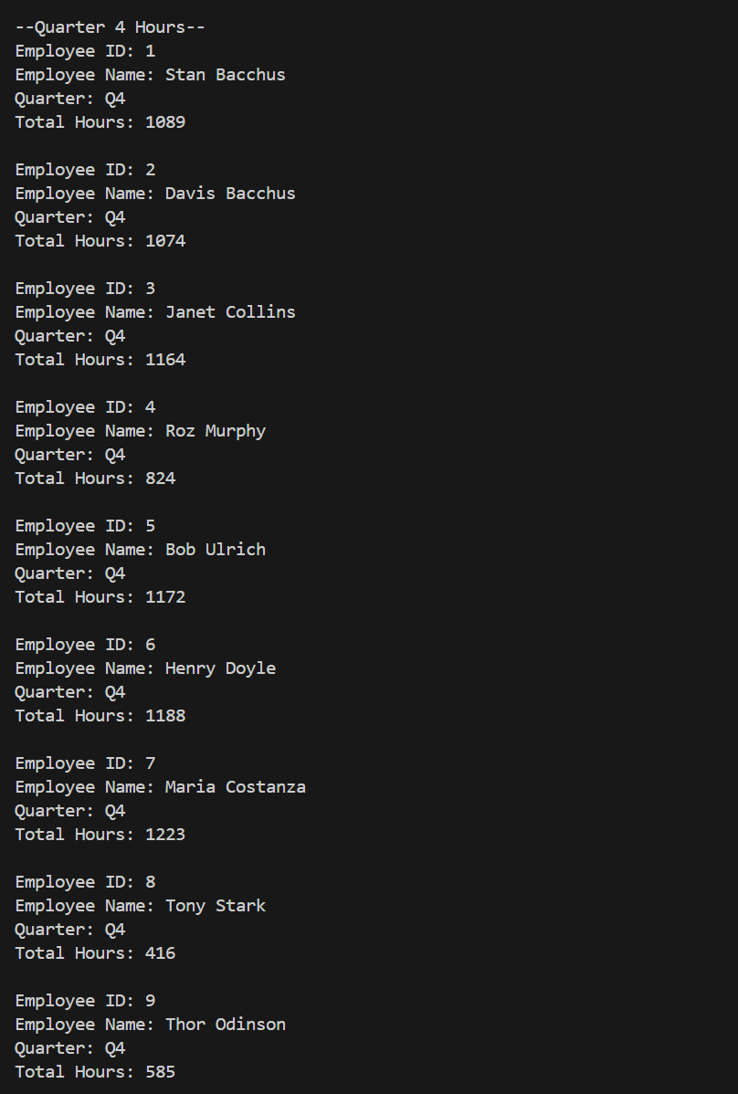
Report 3 (cont’d)
Quarter 4 Results

Slide 10
Case Study Assumptions
Online ordering is in a different database
Everything is ordered online by retailers ( i.e. Costco, Target, etc..)
Chablis does not sell much because it is pricey
Head of department workers are on call
Some workers hours were different in Quarters because of appointments and personal matters
Some workers did overtime for extra money

